Slide 1
COUNTY OF SISKIYOU Department of Agriculture
525 SOUTH FOOTHILL DRIVE ● YREKA, CALIFORNIA 96097-3036 ● (530) 841-4025 ● FAX (530) 842-6690
JAMES E. SMITH
AGRICULTURAL COMMISSIONER AIR POLLUTION CONTROL OFFICER
SEALER OF WEIGHTS AND MEASURES ANIMAL CONTROL OFFICER
ZINC PHOSPHIDE FOR BELDING’S GROUND SQUIRREL CONTROL
PRESENTATION PRODUCED IN COOPERATION WITH THE
OREGON DEPARTMENT OF AGRICULTURE
USE OF THIS PRODUCT MUST MEET ALL FEDERAL, STATE AND LOCAL
REQUIREMENTS, INCLUDING CERTIFIED ANNUAL TRAINING
SISKIYOU COUNTY, CALIFORNIA.
THIS TRAINING DOES NOT MEET ODA REQUIREMENTS.

Slide 2
TRAINER CONTACT INFORMATION
SISKIYOU COUNTY DEPT. OF AGRICULTURE
Jim Smith 530-598-6813
Tony Orr 530-667-5310
OREGON DEPT. OF AGRICULTURE
Laurie Gordon 541-617-6097 Cell
MODOC COUNTY DEPT. OF AGRICULTURE
Gary Fensler 530-667-2713
LASSEN COUNTY DEPT. OF AGRICULTURE
Craig Hemphill 530-251-8110

Slide 3
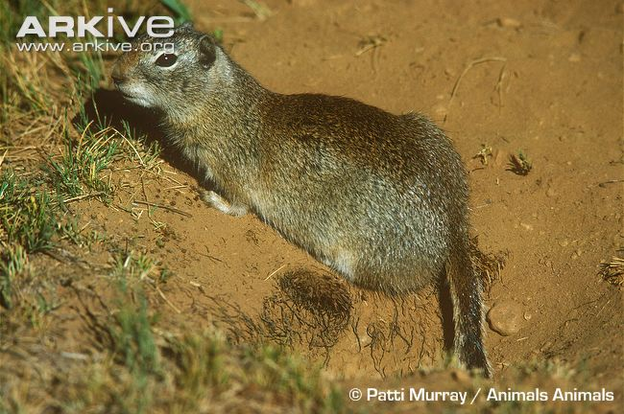
SLN (24c) for Zinc Phosphide Concentrate for Belding Ground Squirrel Control

Slide 4
AGENDA
SPECIAL LOCAL NEED PESTICIDE REG.
ZINC PHOSPHIDE CHEMISTRY AND…
REQUIREMENTS PRIOR TO USE
LABEL REVIEW / USE REQUIREMENTS
PPE REQUIREMENTS
SAFETY REQUIREMENTS
RECORDKEEPING/REPORTING REQ.
QUESTIONS

Slide 5
What is a SLN (24c) Registration?
Under the authority of section 24(c) of FIFRA, states may register additional uses of a federally registered pesticide to meet "special local needs" as long as there is a demonstrated "special local need. (Other uses must already be registered).
EPA Reviews

Slide 6
What is Zinc Phosphide?
Zinc phosphide is an inorganic compound that combines phosphorus with zinc.
Upon contact with moisture in the air, Phosphine gas is released.
Phosphine is a very toxic gas.
Zinc phosphide has been registered since 1947.

Slide 7
How does Zinc Phosphide work?
Animal eats the bait, acid in the stomach turns the zinc phosphide into phosphine gas. Baits are especially dangerous to animals that cannot vomit, such as rats, mice, and rabbits.
The phosphine crosses into the body’s cells, and stops them from producing energy.
Cells then die. Zinc phosphide affects all cells, but targets cells in the heart, lungs, and liver.

Slide 8
Physical & Chemical Properties
Zinc phosphide is a gray-black powder with an odor similar to garlic.
Phosphine is a colorless and flammable gas.
Humans detect phosphine at 2 ppm, although toxicity can occur at lower concentrations.

Slide 9
Exposure Concerns
Routes of Exposure
Absorb through skin
Inhalation
Ingestion
Areas of Concern
Eye Contamination
Contaminate Hands
Eat or smoke without washing your hands first.
Storing food, drink, smokes, etc. with pesticides.
Breathing Dust
During mixing/loading

Slide 10
Signs & Symptoms of Poisoning
Symptoms of exposure
Headache, dizziness, vomiting, and difficulty breathing.
Liver and kidney failure, convulsions, delirium and coma may also occur if a person is exposed to enough phosphine.
If you suspect ZP poisoning
Seek medical attention immediately.
Take a copy of the label.

Slide 11
Signs & Symptoms of Poisoning
Animal Exposure (similar to humans)
Signs include vomiting, anxiety, and retching.
Stagger or loss of coordination.
Signs can start in less than an hour, or up to 12 hours if the stomach was empty. (Have you seen a squirrel with an empty stomach in an alfalfa field?)

Slide 12
Signs & Symptoms of Poisoning
Zinc phosphide is very toxic to birds, fish, other wildlife, dogs and cats.
Do not allow livestock, pets, or domestic animals in the mixing area or when applying the treated cabbage in the field.
Keep dogs and cats out of treated fields.

Slide 13
What is the Risk of Secondary Poisoning?
Secondary Poisoning
Predator or Scavenger eats dead squirrel and dies.
Secondary poisoning appears to be rare in wildlife.
Risk correlated to consumption of the gastrointestinal tract of the poisoned animal.
Domestic dogs and cats appear to be more likely to consume the gastrointestinal tract of poisoned prey than are wild animals.

Slide 14
How Does ZP Break Down?
Zinc phosphide releases phosphine gas when exposed to water or moist soil in the environment, and in highly acidic conditions.
Phosphine given off will be broken down by air.
Phosphine cannot contaminate food or water.
National Institute for Occupational Safety and Health

Slide 15
ZINC PHOSPHIDE BAITING
FIRST STEP
Identify the problem!
Belding Ground Squirrel
VS other burrowing rodents
SECOND STEP
Estimate infestation level
Calculate material needs

Slide 16
Belding Ground Squirrels (Urocitellus beldingi)
© scary squirrel world
Belding’s Ground Squirrel aka Sage Rat, Squeaks, Whistle pigs
They are not Grey Diggers (California Ground Squirrel )

Slide 17
Belding Ground Squirrel Facts
Hibernators, emerge Feb/March
Estivate at times during the summer
Estivate means spends a hot or dry period in a prolonged state of torpor or dormancy. Torpor means a state of physical or mental inactivity.
Not a protected species

Slide 18
Belding Ground Squirrel Facts
One annual litter of 7-8 average
Lifespan: 5-8 years
Home range– 75 yard radius from the burrow
Burrows always open
Herbivores
Belding’s – Diet remains heavily slanted toward green succulent vegetation rather than seeds.
CA Ground Squirrel - Green vegetation in spring, switch to seeds in the summer
Implications for control

Slide 19
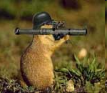
Ground Squirrel Damage
Feeding on crops
Undermine roads, weaken levees/ditches/damns
Disease transmission
Bubonic Plague
Rodent carried bacteria
Spread by fleas
Siskiyou County
0 cases in last three years
Siskiyou County Public Health
© 2008 - The Regents of the University of California.
Burrowing
Equipment Costs
Poor Quality Forage
Dirt (Soil)
Irrigation Impacts
Yield Effects

Slide 20
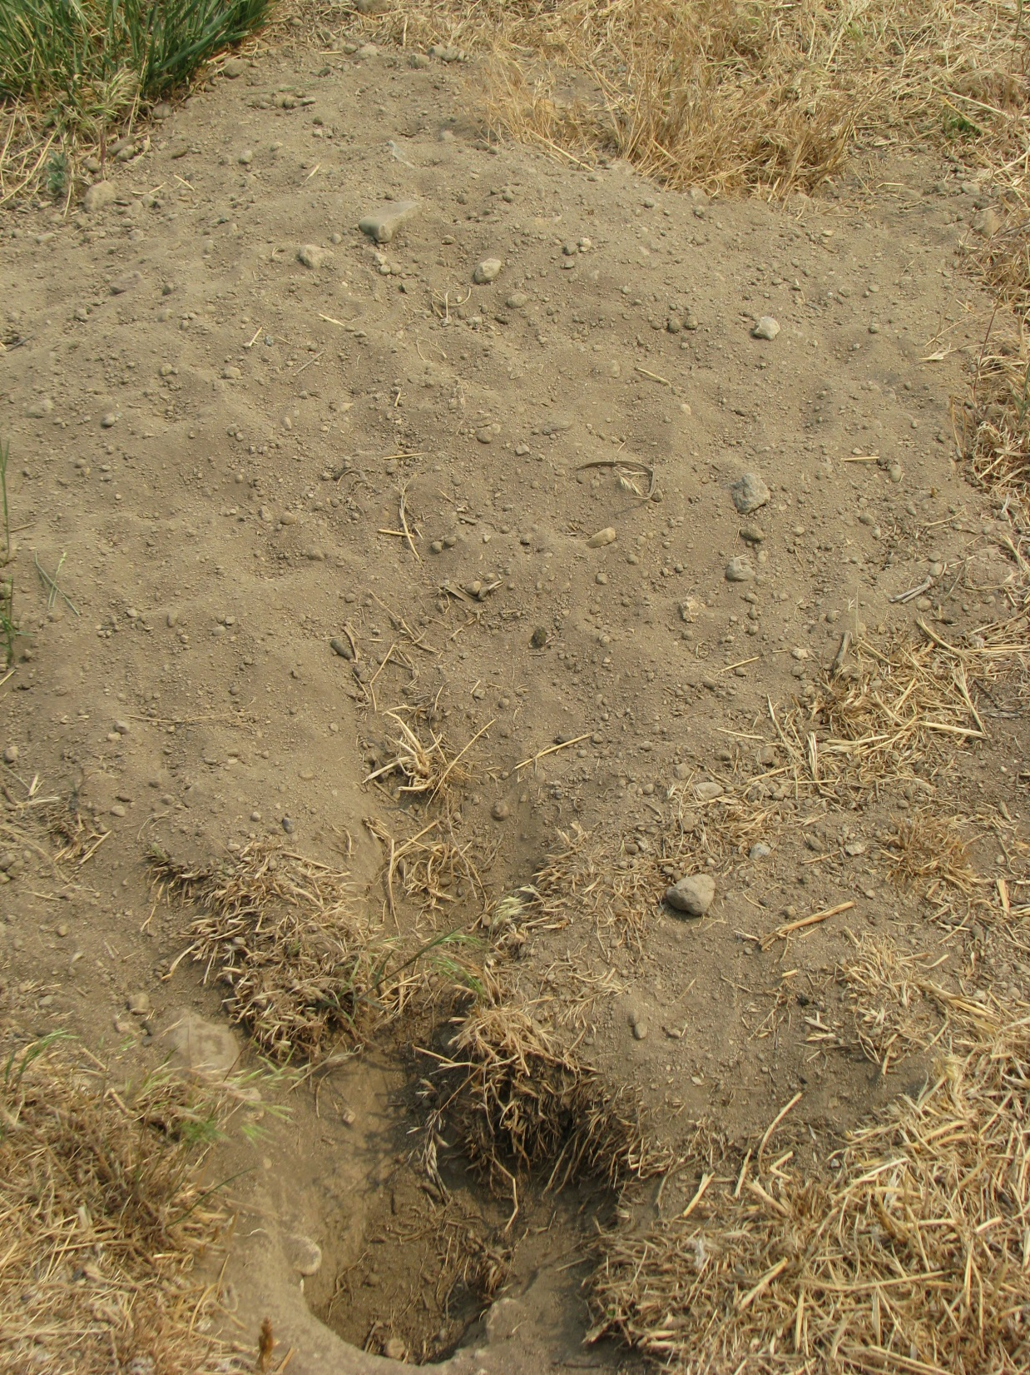

Slide 21
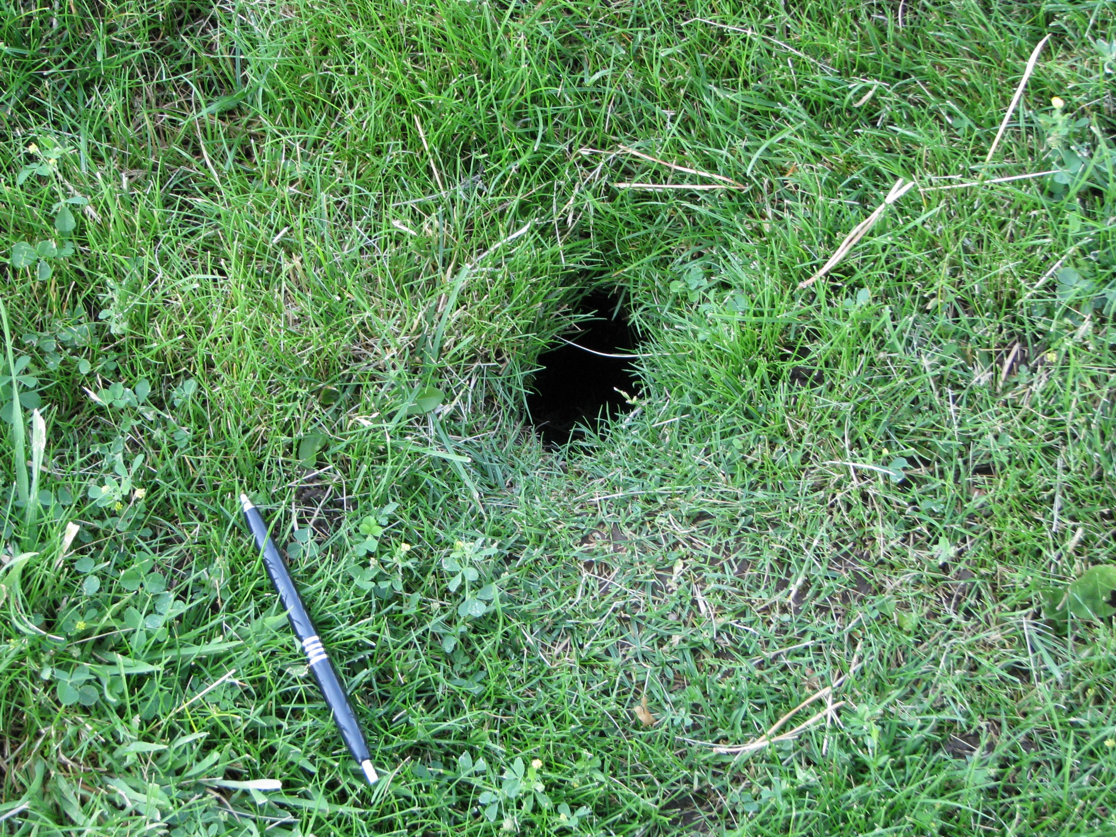

Slide 22
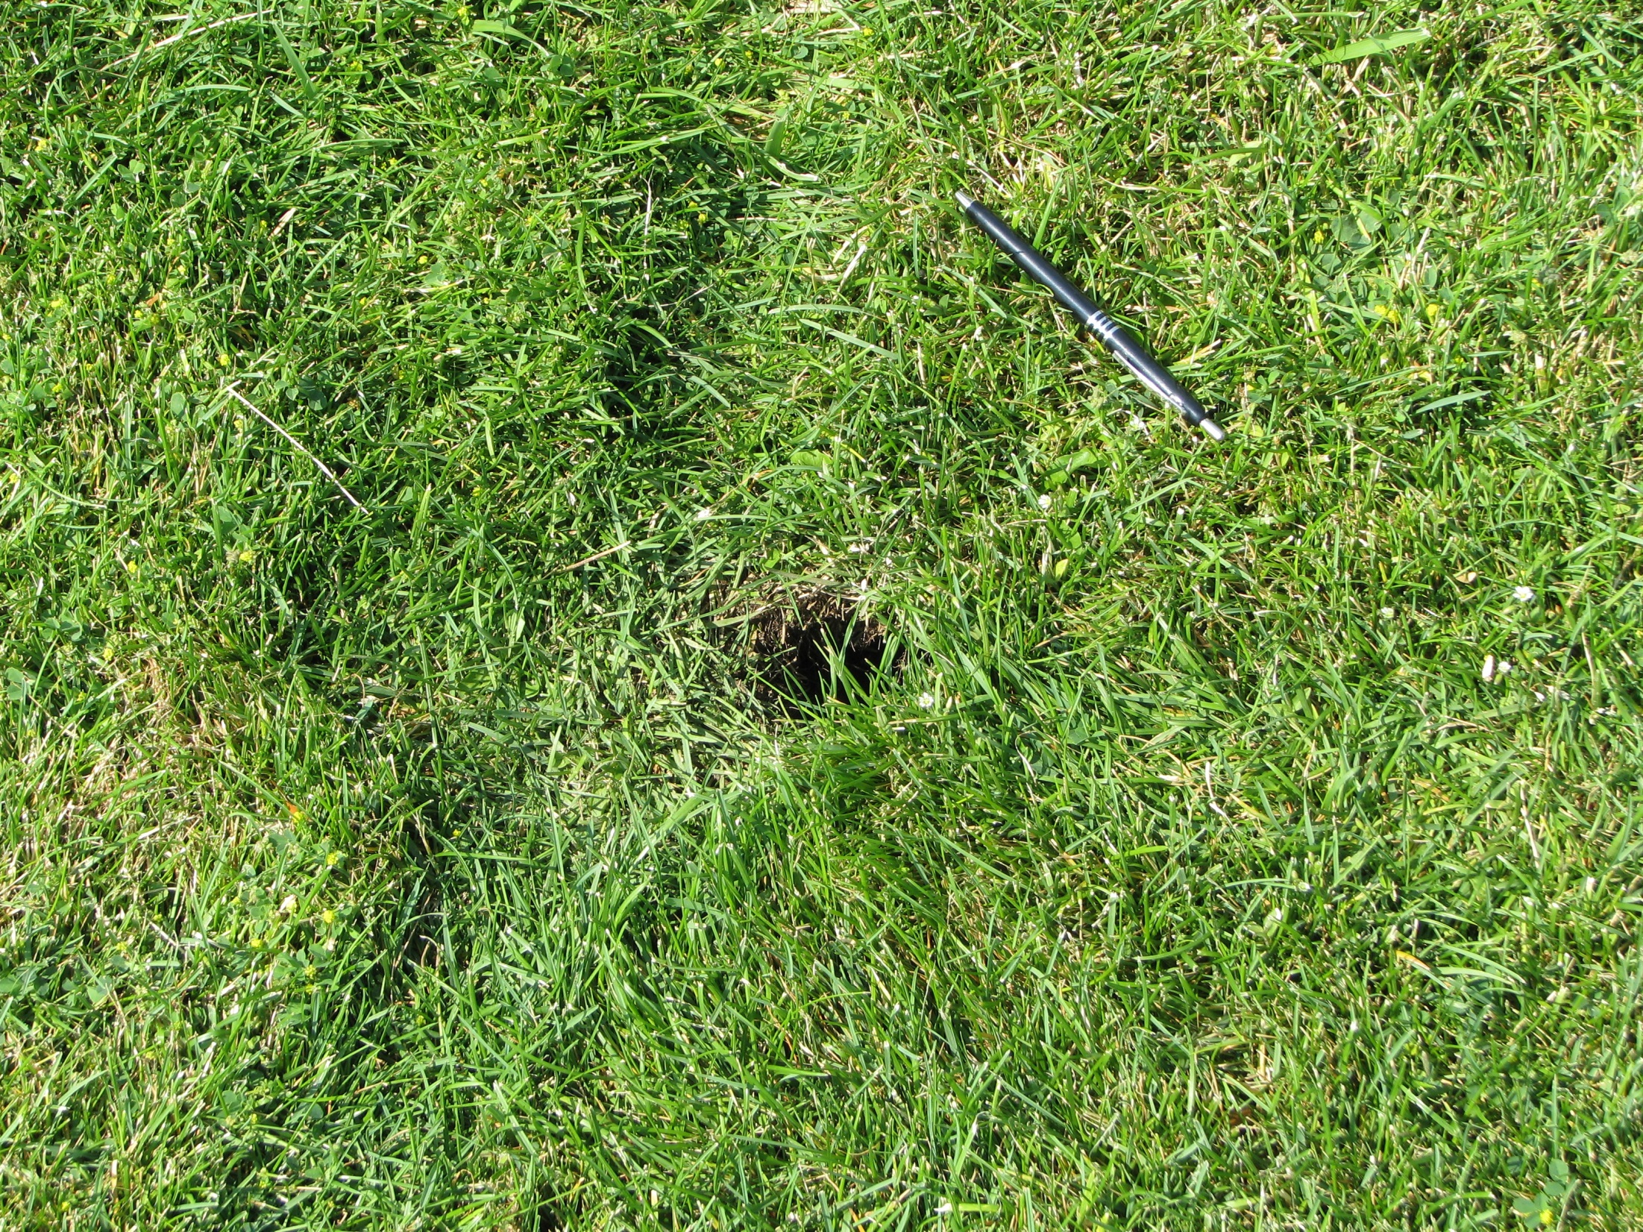

Slide 23
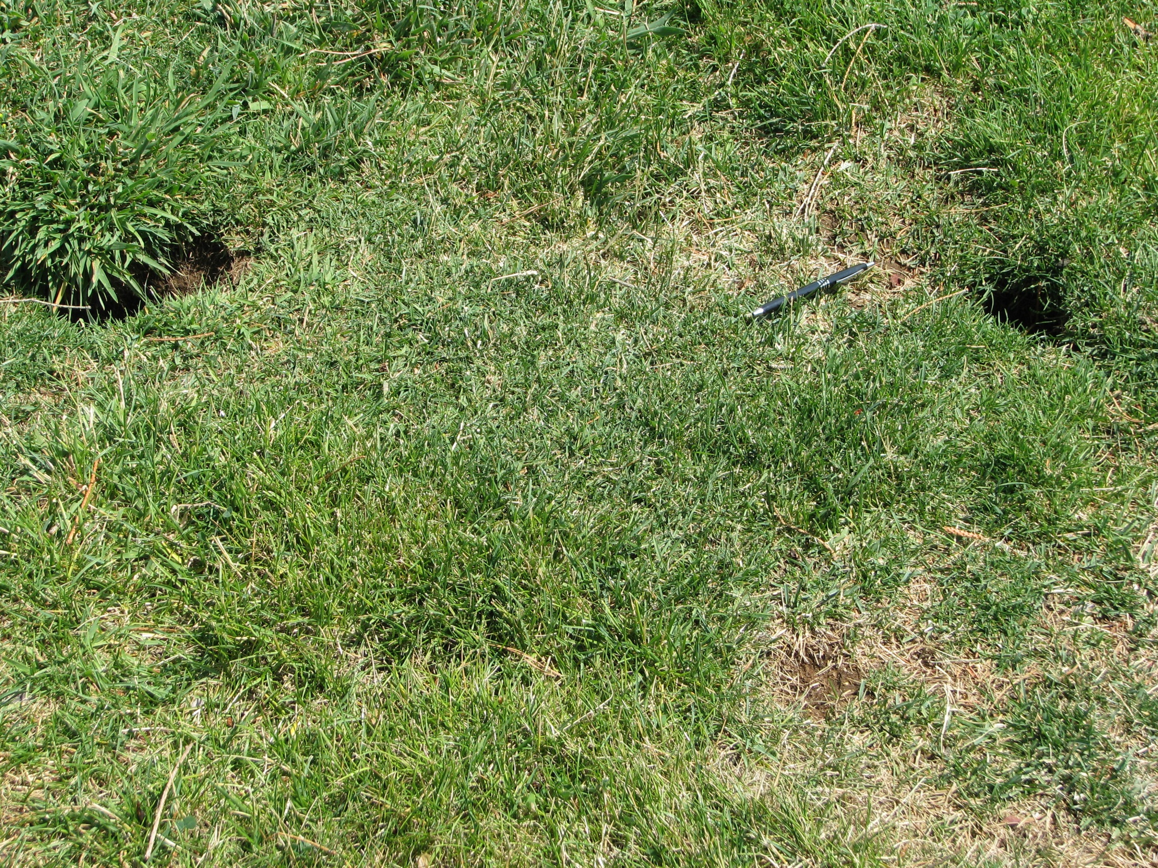

Slide 24
Zinc Phosphide
Zinc phosphide
Restricted Use
Reacts with moisture
Do not use bait stations
Spot baiting only
Pre-bait to avoid bait shyness
Low risk of non-target poisoning and secondary poisoning
Not to be used in fields where “geese or other migratory birds have been within the last 14 days"

Slide 25
The ZP SLN Label CA-150001
Restricted Use Pesticide
DUE TO ACUTE ORAL, DERMAL AND INHALATION HAZARDS TO HUMANS AND HAZARDS TO NONTARGET SPECIES. For retail sale to and use only by Certified Applicators or persons under their direct supervision and only for those uses covered by the Certified Applicator’s certification.
EPA REG. NO. 53228-6

Slide 26
The ZP SLN Label CA-150001
FOR DISTRIBUTION AND USE ONLY WITHIN MODOC, LASSEN and SISKIYOU COUNTIES, CALIFORNIA.
This label is valid until withdrawn, suspended or cancelled by the United States Environmental Protection Agency (USEPA), the manufacturer, the 24(c) registrant, or the Department of Pesticide Regulation, or expires on December 31, 2020.

Slide 27
The ZP SLN Label CA-150001
This product may only be used to control Belding’s ground squirrels in alfalfa, pasture, rangeland, and non-crop areas (utility rights of ways, rights of ways, uncltivated non ag areas, and ditch banks/areas around ditches) between January 1 and May 31, or until new spring growth averages 4 inches, whichever occurs first.

Slide 28
The ZP SLN Label CA-150001
TRAINING REQUIREMENT: Before purchasing, mixing or applying this product, individuals must first receive special training conducted by the Agriculture Commissioner in Siskiyou County, California or the Oregon Department of Agriculture for Oregon, on the use of this product. This training is required every year.

Slide 29
The ZP SLN Label CA-150001
Read the main product label for Zinc Phosphide Concentrate (EPA Reg. No. 56228-6)
Read the entire SLN label,
This product must be used strictly in accordance with the precautionary statements and applicable use directions on both labels, as well as with all applicable State and Federal laws and regulations.
The Personal Protective Equipment (PPE) requirements on this SLN label must be followed.
Coveralls are required for any Danger/Warning Pesticide

Slide 30
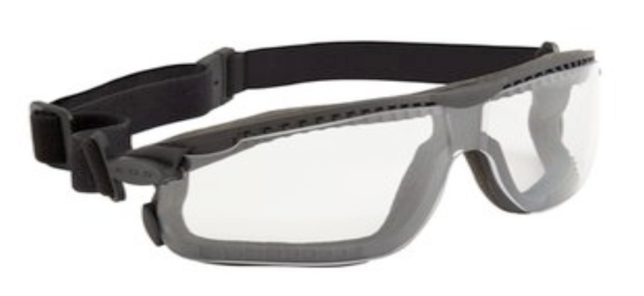
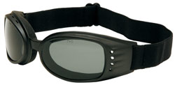
The ZP SLN Label CA-150001
PERSONAL PROTECTIVE EQUIPMENT (PPE):
All mixers/loaders, including persons handling open containers of concentrate product and persons who clean or repair mixing equipment, must wear: - coveralls over long sleeve shirt and long pants; - shoes plus socks;
- chemical-resistant gloves; - dust goggles.

Slide 31
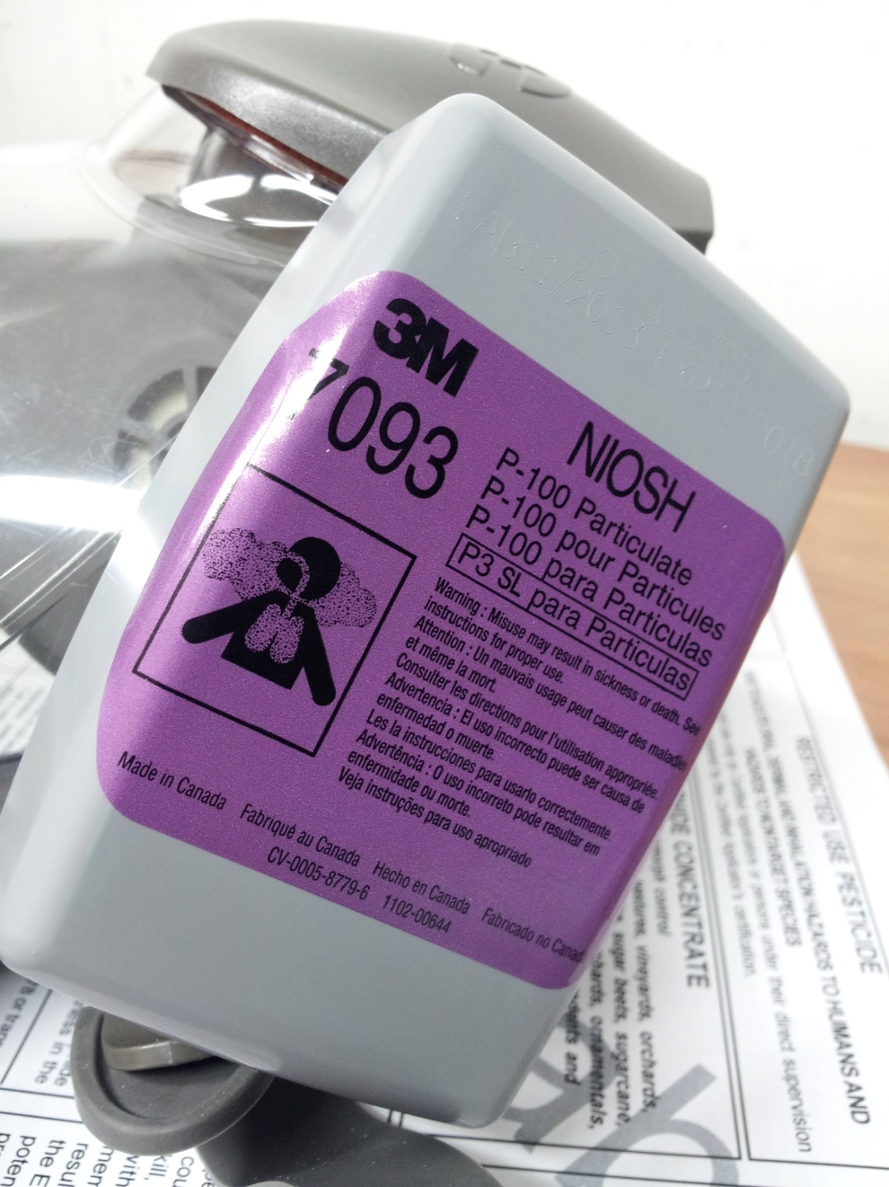
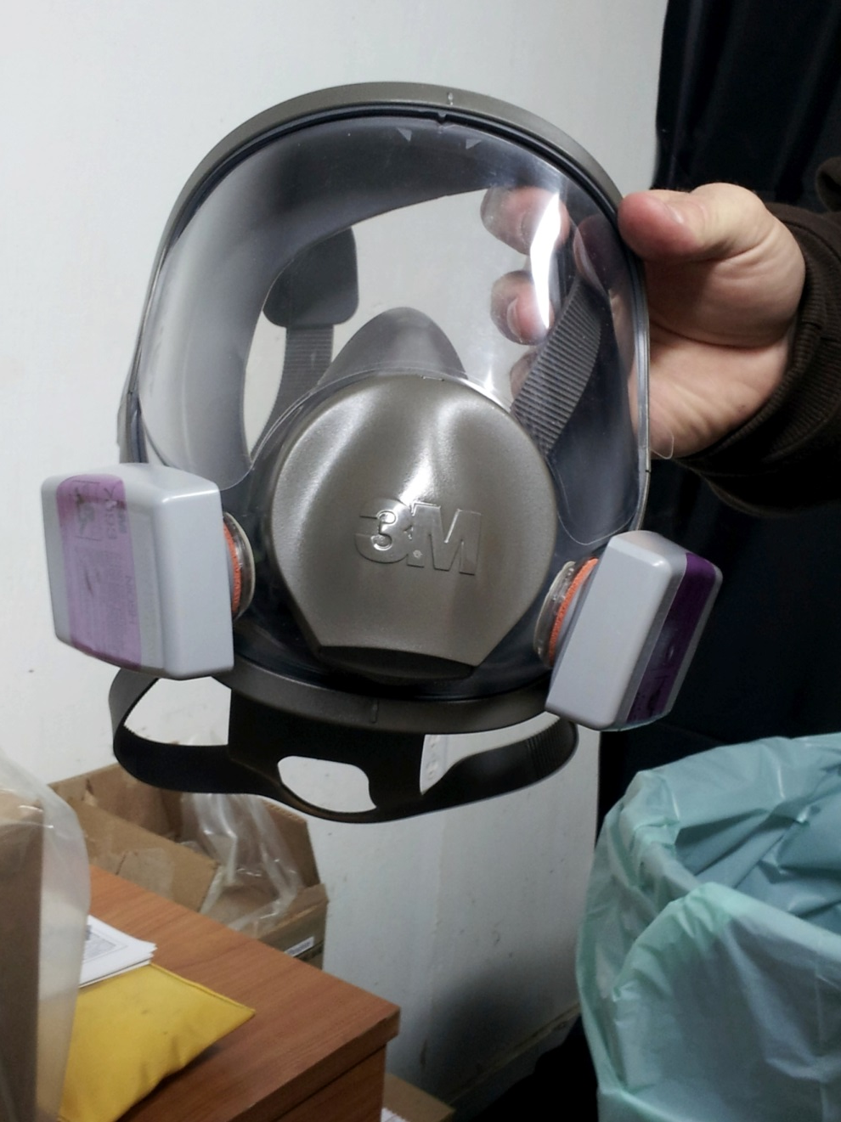
A NIOSH-approved particulate filtering respirator equipped with N, R, or P class filter media.
NIOSH approval number prefix TC-84A

Slide 32
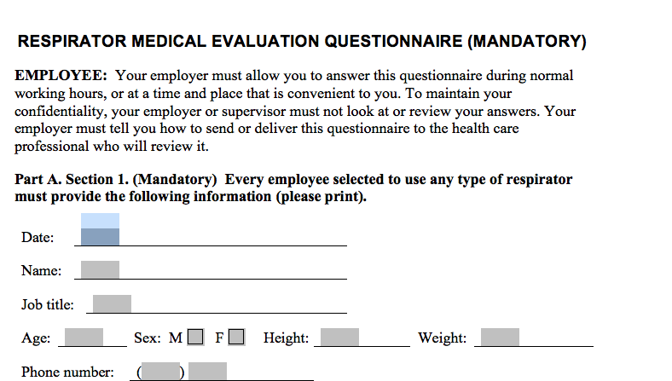
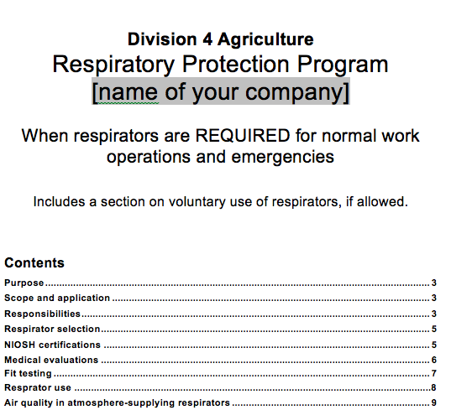
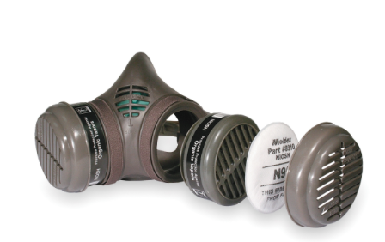
Example of a NIOSH approval # prefix TC-84A

Slide 33
DIRECTIONS FOR MIXING/HANDLING/APPLYING TREATED (TOXIC) BAIT
All persons who handle and/or mix Zinc Phosphide Concentrate must be licensed Pesticide Applicators.
Additionally, all persons who mix, handle, and/or apply the Zinc Phosphide Concentrate/cabbage treated bait must first receive special training conducted by the Siskiyou County Agriculture Commissioner, or the Oregon Department of Agriculture.

Slide 34
DIRECTIONS FOR MIXING/HANDLING/APPLYING TREATED (TOXIC) BAIT
Wear required PPE as specified on this SLN.
To minimize the possibility of airborne zinc phosphide dust particles, do not shake the Zinc Phosphide Concentrate container immediately prior to opening.
Mixing of bait outdoors reduces the deposition of dust in an indoor space area.

Slide 35
The ZP SLN Label CA-150001
All applicators and persons who retrieve carcasses and unused bait must wear:
- coveralls
- shoes plus socks - water-resistant gloves
- protective eyewear that provides temple and brow protection

Slide 36
Pre-baiting
PRE-BAITING DIRECTIONS:
Pre-baiting is required in Siskiyou County
Only use cabbage as the pre-bait and bait.
Pre-baiting with untreated cabbage of the type to be used for toxic baiting may lead to more consistent acceptance of the toxic bait.
Apply untreated (pre-bait) cabbage at rates similar to what will be used for treated (toxic) cabbage.
You must pre-bait with untreated cabbage for 2- 3 days before applying treated bait.
Do not apply toxic bait at burrow openings where pre-bait has not been consumed.

Slide 37
Preparing Pre-baiting
To prepare pre-bait:
Cut cabbage into strips that are 2 – 6 inches long by 1⁄4 - 1⁄2 inch wide.
Drain fluids or juices from cabbage.
Do not shred cabbage.
Place 10 pounds of cut-up cabbage in a 5-gallon container.
Mix cabbage with vegetable oil (use same type as you will when making toxic bait) at a rate of 1.0 to 2.0 fluid ounces of oil per 10 pounds of cabbage.
Tumble or stir mixture until oil is evenly mixed with bait.

Slide 38
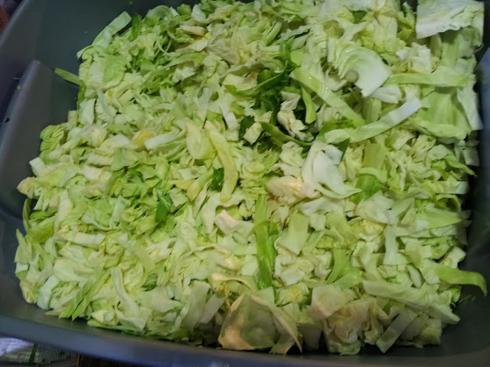
SLICED CABBAGE

Slide 39
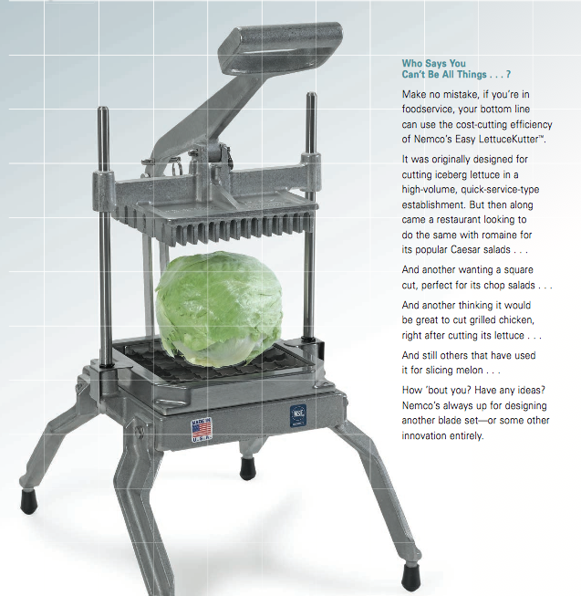
Nemco Easy LettuceKutter
- This unit sits on a table top or work bench.
- Stands 20” tall.
- You want model # 55650-1 which cuts ½” strips that are between 2” – 6” long.
- Grower reports they can cut 3000 lbs. of cabbage in about 5 hrs.-

Slide 40
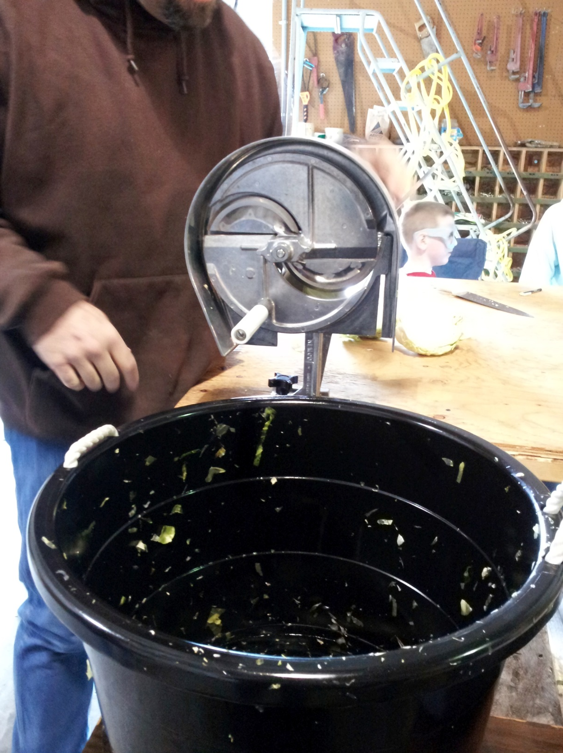
Nemco Easy Vegetable Cutter
Model # 55200AN, has an adjustable blade.
Growers that had purchased this model prefer the previous model.
Very tiring to use this model and slower.

Slide 41
Where to order slicers?
Nemco
Slicers are drop shipped to you.
Bend, OR:
Bargreen Ellingson, 877-309-9400
Sacramento, CA:
Dong Vinh, 916-391-8181

Slide 42
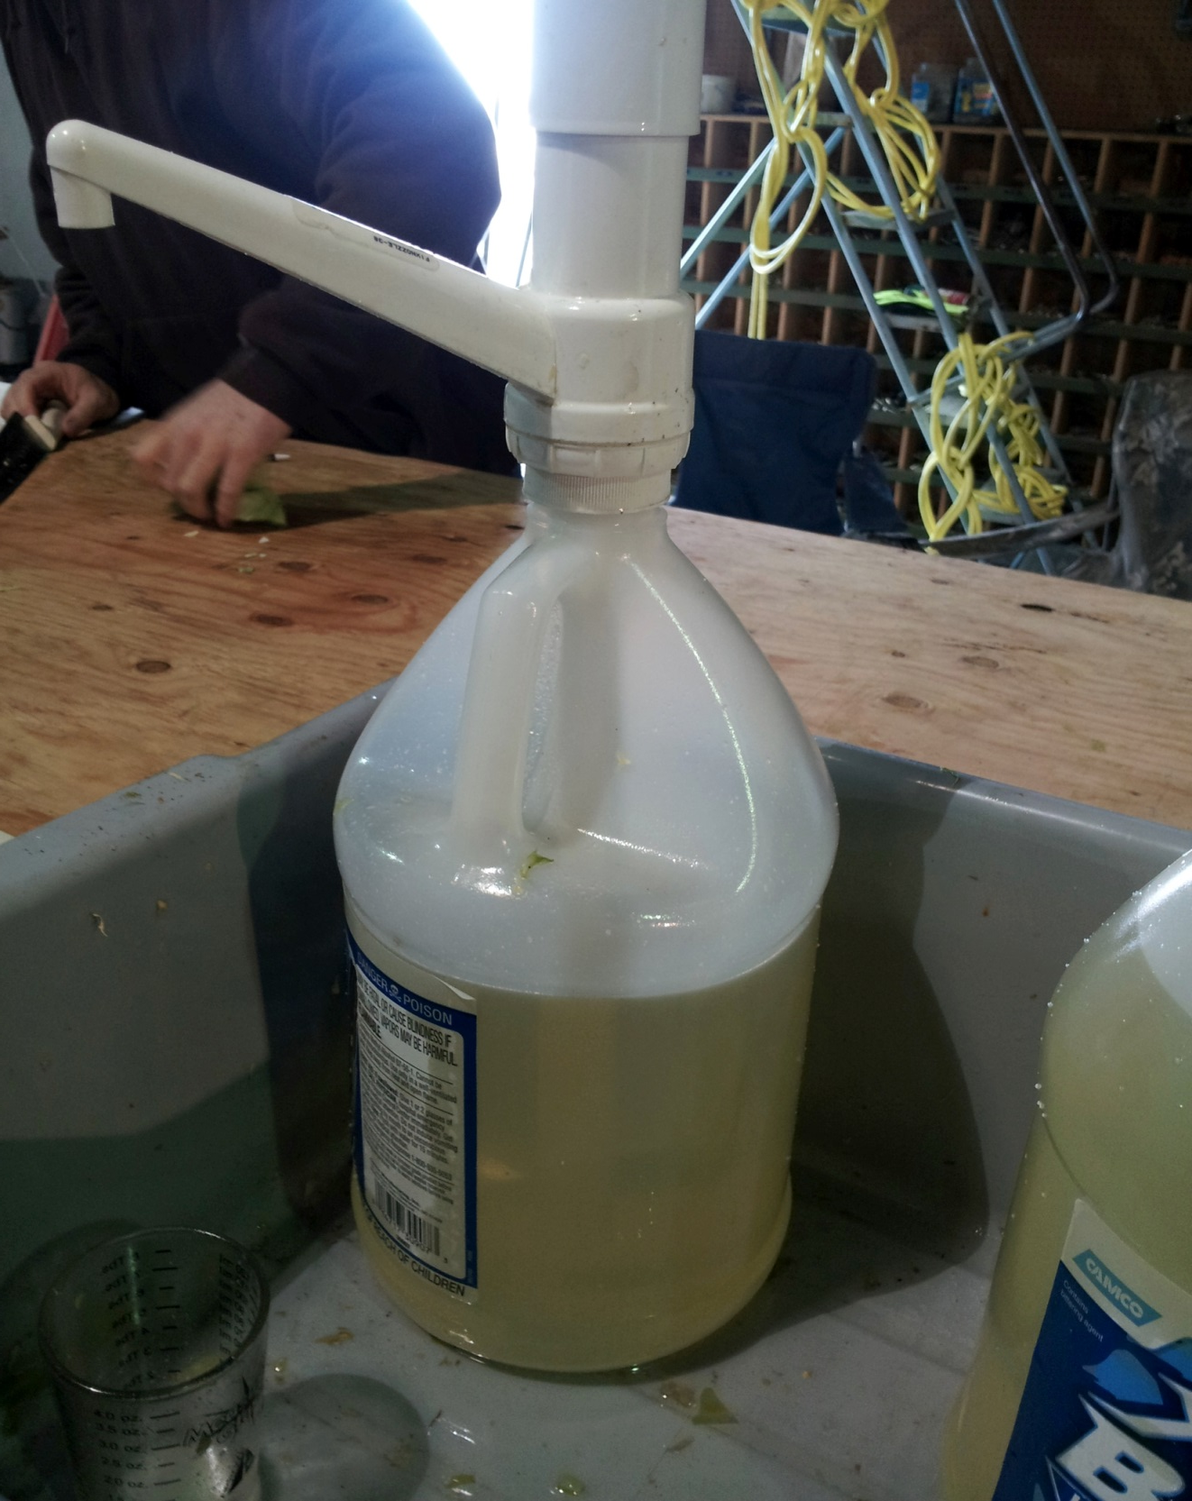
Oil, pump, and bus boy container can be purchased at Cash & Carry or other restaurant suppliers. Puts out about 1 oz. of oil per pump.

Slide 43
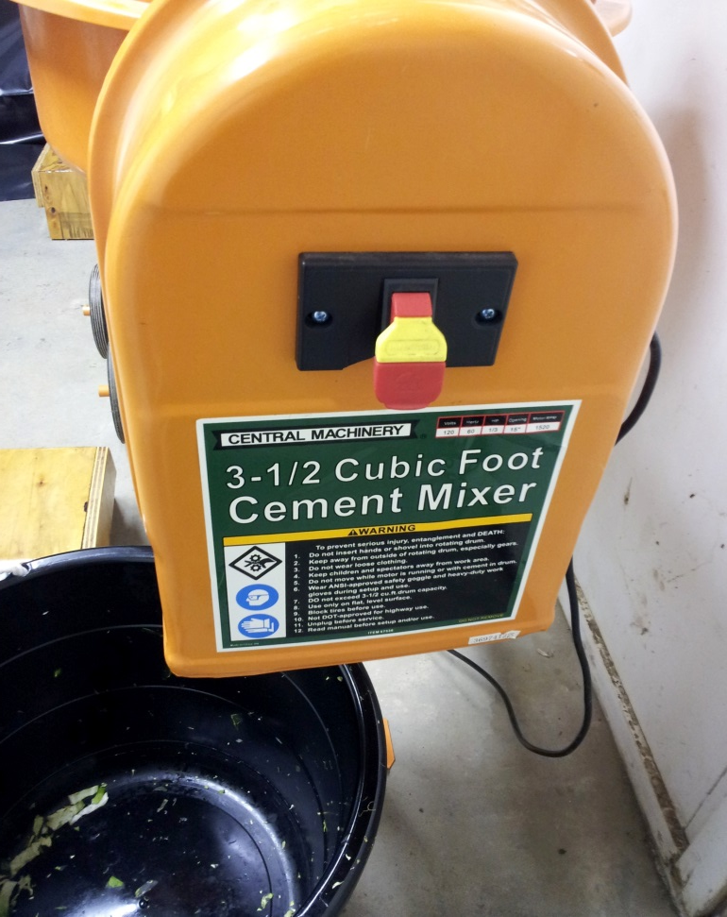
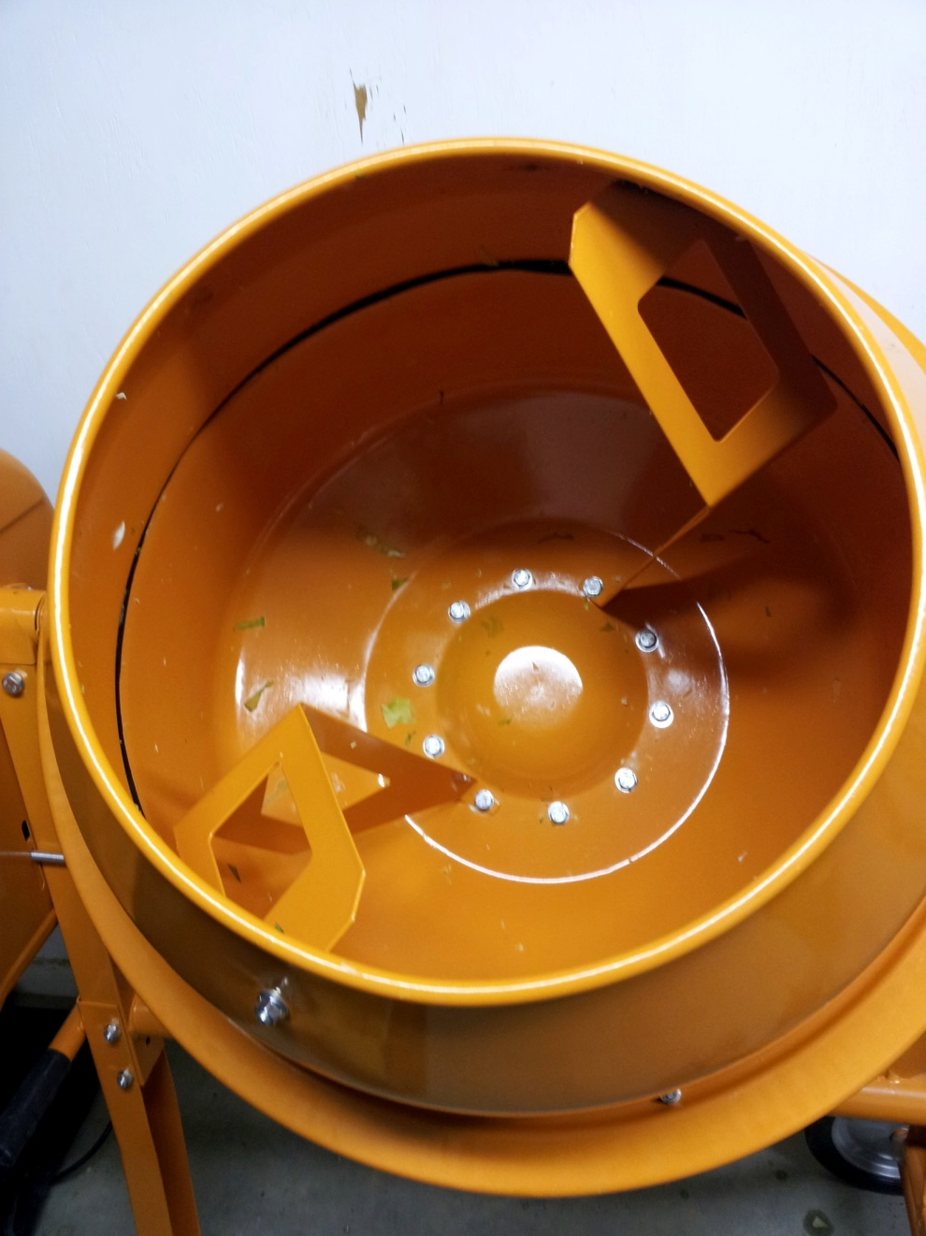
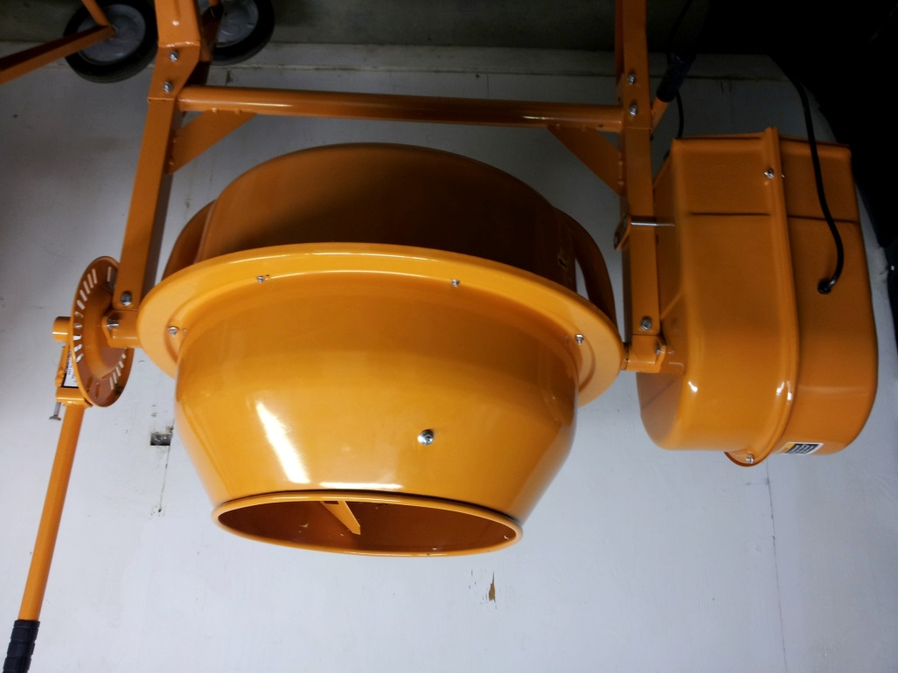

Slide 44
APPLICATION DIRECTIONS FOR TREATED BAIT:
Spot Baiting: Scatter 0.05 ounces of treated cabbage leaves around active burrow entrances; placement of bait by runway is ideal.
Do not broadcast treated cabbage.
Apply treated bait at a rate up to 10 pounds per acre.
A second application may be made after 10 days.
A maximum of 20 pounds treated bait per acre may be applied per year.

Slide 45
Timing:
All applications must occur between January through May, except in Siskiyou County where applications are limited from January and prior to new spring growth averaging 4 inches in height, (January – approximately April), but never past the end of May.
Male ground squirrels usually emerge prior to female ground squirrels.
It is suggested that applications of pre-bait and treated bait take place in the early to mid-afternoon, so bait is available for evening feeding.
This will minimize the potential for non-target exposure.

Slide 46
SPECIFIC USE RESTRICTIONS
Preharvest Interval is 30 days.
Only spot baiting of active infested area.
Do not broadcast treated cabbage.
Do not bait if non-target birds/animals are feeding, nesting, etc., in the area to be treated.
Do not apply in rain or on snow.
Do not apply in urban areas.
Do not allow domestic animals to graze fields treated within the last 60 days.
Do not apply by air.
Do not allow hunting in treated fields during application period.

Slide 47
SPECIFIC USE RESTRICTIONS
Do not allow hunting in treated fields during application period.
Fields to be treated and treated fields must be monitored daily for non-target species.
Properly dispose of dead rodents.
If migratory birds are present, hazing must be accomplished before and after applications to prevent non-target exposure.
Collect and bury any spilled bait, unused prepared bait, and uneaten bait, wearing required PPE.
Apply when daytime temperatures are above freezing.

Slide 48
SPECIFIC USE RESTRICTIONS
Any dead animals found in the treated areas must be immediately reported to the local county Agriculture Commission’s office. (Non-Target species only)

Slide 49
ADDITIONAL RESTRICTIONS
Do not apply this product by air.
Do not allow hunting in treated fields during application period.
Do not bait unoccupied, inactive, or dormant burrows. Follow the directions for use regarding pre-baiting.
Collect and bury any spilled bait. Bury any treated bait that has been prepared, but was not applied.

Slide 50
ADDITIONAL RESTRICTIONS
Any uneaten bait that has not decomposed within three days after baiting must be collected and buried, unless the field is irrigated (overhead irrigation) within that time. Irrigation should accelerate the decaying of treated cabbage leaves and the deactivation of zinc phosphide.
All applicators and other persons who retrieve carcasses, spilled bait or uneaten bait must wear water-resistant gloves and either dust goggles, face shield, or other protective eyewear that provides temple and brow protection.
Apply when temperatures are above freezing and do not place prepared bait on snow.
Do not apply in the rain.

Slide 51
SISKIYOU COUNTY PERMIT CONDITIONS
Restricted Materials Permit Required
You must have a current Restricted Materials Permit with Zinc Phosphide listed prior to purchasing or using this material
Permit Conditions Signed
You must agree to and sign the Zinc Phosphide Cabbage Bait Permit Conditions prior to purchase or use of this material.
Certified Applicator Only
You must have a Certified Applicators License prior to purchase or use of this material Certified Applicators include licensed Private Applicators, Qualified Applicator Licenses, and Qualified Applicator Certificates.
Notice of Intent
A notice of intent shall be filed with the Commissioner’s office twenty four hours (24) prior to the application start.

Slide 52
SISKIYOU COUNTY PERMIT CONDITIONS
Certified Applicator Training is required in Siskiyou County
Siskiyou County Approved training prior to purchase or use of this product is required. Approved training includes Siskiyou County Dept. of Agriculture training, and Oregon Dept of Agriculture training. Documentation is required.
Pre-Baiting is required in Siskiyou County
Pre-baiting with like cabbage strips 24 hours prior to applying treated cabbage is required.
Application Timing Limitations
Applications within Siskiyou County shall cease when regrowth of crop, including alfalfa, grassy alfalfa, pasture, rangeland, and non-crop areas reach 4 inches in height. If this limitation has not been reached before label mandated use restrictions, than the sln label applies (May).

Slide 53
SISKIYOU COUNTY PERMIT CONDITIONS
Label and SLN Label in Possession
A copy of the label for Zinc Phosphide and the SLN label shall be in your possession prior to purchase and use of this material and during applications.
You will receive a copy of both documents when you get your permit from the County Dept. of Agriculture
Oregon applicators will need to get these documents from ODA

Slide 54
MIXING AND APPLICATION EQUIPMENT CLEANUP:
Thoroughly clean all mixing and application equipment when applications of treated bait have been completed.
Remove all leftover treated cabbage and bury.
Clean all surfaces of the mixing bins, mixing equipment, measuring devices, and PPE with hot water and detergent or with low pressure steam.
Do not contaminate surface or ground water by the cleaning of equipment or disposal of wastes.

Slide 55
Applicator Recordkeeping Requirements
The brand or product name
The EPA registration number
The total amount applied
The month, day, and year
The location of the application
The crop, commodity, stored product, or site
The size of area treated
The name of the certified applicator
The certification number of the certified applicator
Applications need to be reported within 10 days of the application
Application records must be kept for 2 years

Slide 56
PRODUCT ORDERING INFORMATION
County will provide supplier with approved operators, including permits, license information and training records.
After this information has been delivered, Wildlife Services State Office in California
will process called in orders.
LORENZO BRIDGERS
916-979-2675
916-979-2030

Slide 57
DOCUMENT POSSESSION REQUIREMENTS
COPY OF MASTER ZINC PHOSPHIDE LABEL
COPY OF THE ZINC PHOSPHIDE SLN LABEL
COPY OF THE CERTIFICATE OF COMPLETION FROM ONLINE TRAINING
RESTRICTED MATERIALS PERMIT AND APPLICATORS LICENSE

Slide 58
APPLICATOR TRAINING RECORDS
ALL HANDLERS MUST BE TRAINED
ALL HANDLERS MUST TAKE THE ONLINE SISKIYOU COUNTY ZINC PHOSPHIDE TRAINING, FILL OUT THE CERTIFICATE OF COMPLETION, AND HAVE IT IN THEIR POSSESSION AT THE APPLICATION SITE

Slide 59
Zinc Phosphide SLN Label (Double Click to Enlarge)

Slide 60
SISKIYOU COUNTY DEPARTMENT OF AGRICULTURE
ZINC PHOSPHIDE APPLICATION TRAINING CERTIFICATE OF COMPLETION
_________________
PRINT NAME
HAS COMPLETED THE REQUIRED TRAINING COURSE: ZINC PHOSPHIDE APPLICATION TRAINING, AND IS HEREBY AUTHORIZED TO APPLY THIS MATERIAL AS THE SPECIAL LOCAL NEED PESTICIDE LABEL, RESTRICTED MATERIALS PERMIT AND PERMIT CONDITIONS DIRECTS.
Completed this ___ day of __________, 20__
Signature

